Slide 1




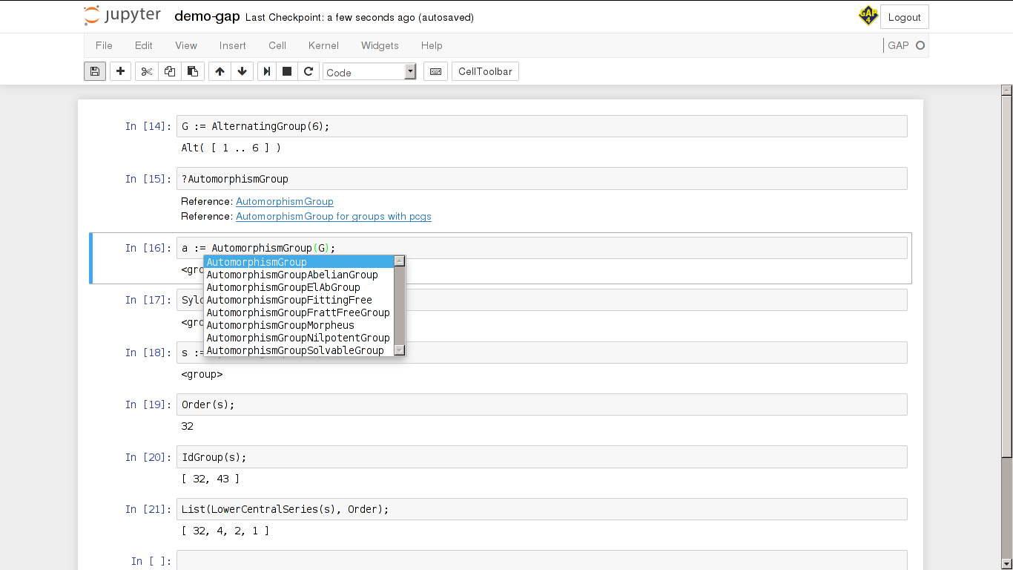
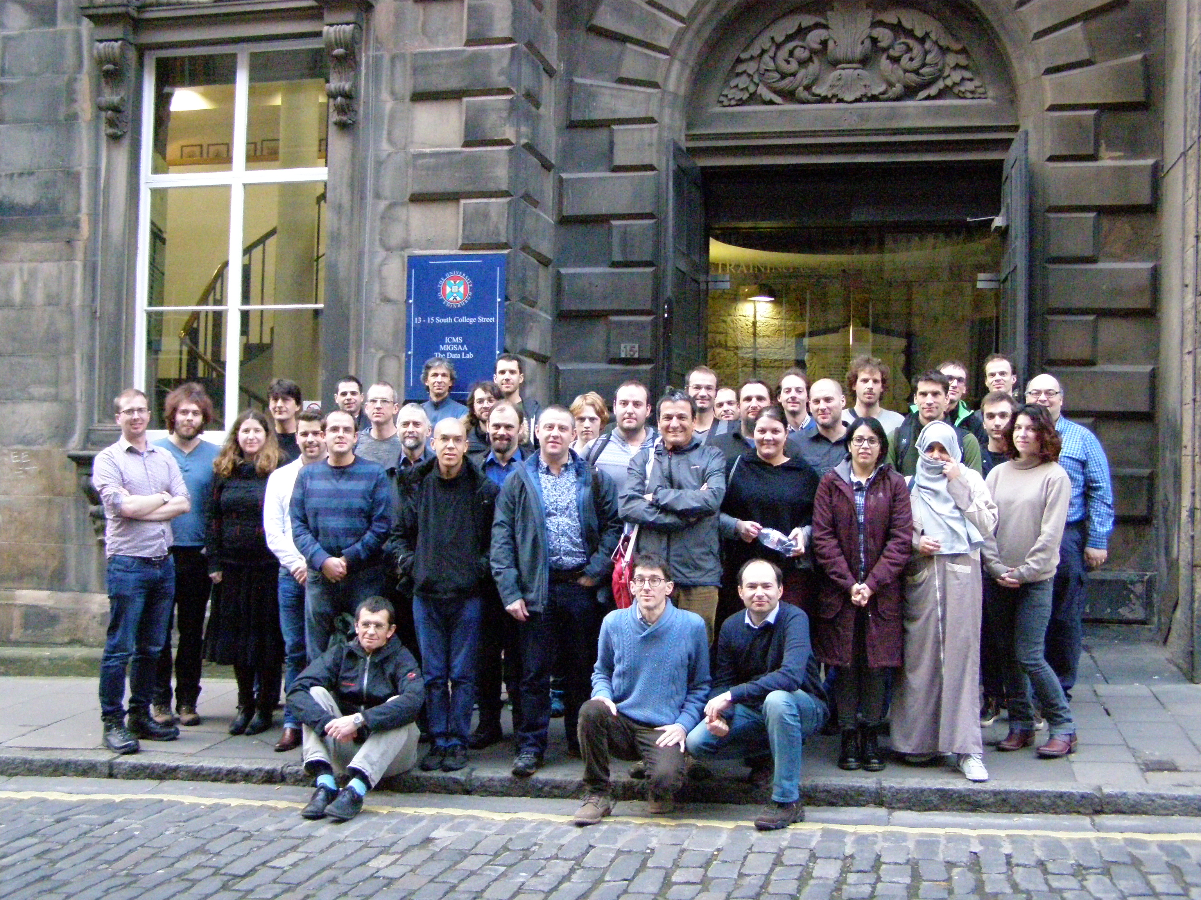

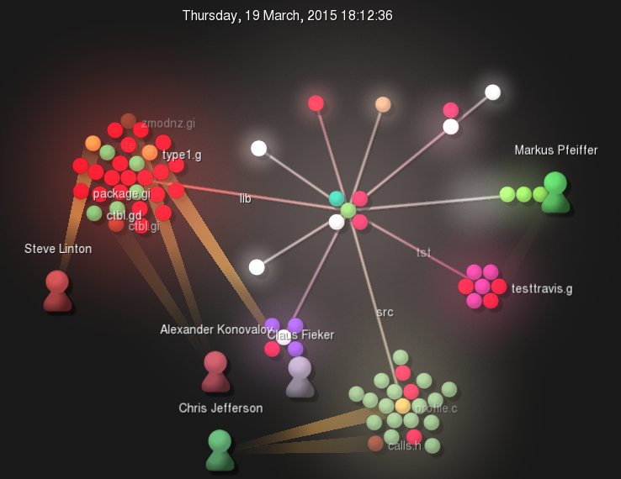
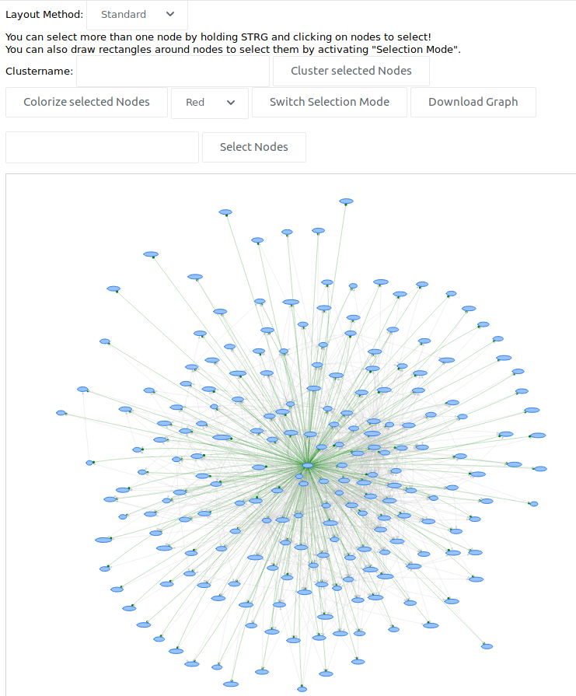
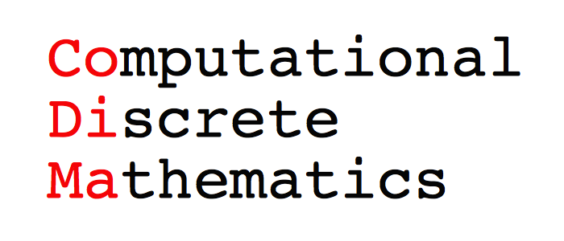


GAP – Groups, Algorithms, Programming
Better Mathematical Software For Better Mathematical Research
Recent developments relevant to OpenDreamKit
University of St Andrews, St Andrews, Fife, KY16 9SX
http://www-circa.mcs.st-and.ac.uk/, Twitter: @CIRCA_StAndrews
Our software
Jupyter kernel for GAP - WP3
Training and networking – WP2
GAP (Groups, Algorithms and Programming) is a software system for discrete computational algebra with an emphasis on computational group theory. It provides a language called GAP, a library of mathematical algorithms implemented in this language and various libraries of mathematical objects, such as, for example, the 423 164 062 groups of order not greater than 2000, (excluding 49 487 365 422 groups of order 1024).
GAP (http://gap-system.org, @gap_system on Twitter) is an open-source project, started in RWTH Aachen in late 80s. Since 1997 its development has been coordinated by CIRCA (the Centre for Interdisciplinary Research in Computational Algebra) at the University of St Andrews. GAP is used for research and teaching at several thousands universities and research institutions worldwide and has been cited in several thousand research publications.
A Jupyter kernel for GAP is available via PyPI: https://pypi.python.org/pypi/jupyter-kernel-gap
Compatible with the latest public GAP release of GAP 4.8.7 (March 2017)
1st GAP-SageMath Days (St Andrews, Jan. 2016)
“Computational Mathematics with Jupyter” workshop (ICMS Edinburgh, Jan. 2017)
SageMath-GAP Days 85 (Cernay, Mar. 2017)
Also available as a Docker image from https://hub.docker.com/r/gapsystem/gap-docker-jupyter/
High-performance computing – WP4
We welcome contributors
Integrating the experimental HPC-GAP variant into the main GAP codebase
Improving portability and reliability of the system
Started work on integrating high-performance Meataxe64 linear algebra system into GAP to work with very large matrices over small finite fields
Many performance enhancements throughout the system
Find us on GitHub:
https://github.com/gap-system
https://github.com/gap-packages
Mathematical knowledge
Management – WP6
Tools to explore GAP type system:
with human-readable output for GAP users and developers
with machine-readable output to be used by other software
GAP has a wide user base, including researchers, educators and students, and has a mechanism for user contributions in the form of packages, which may be submitted for refereeing and for the redistribution with GAP. In particular, the latest GAP release, 4.8.7 (March 2017) contains 132 package.
There are many areas where GAP users face a need for larger and more sophisticated computations, for example, computational homological algebra, direct computations in the Monster simple group and in infinite matrix groups.
A moment of collaborative work at 2nd GAP Days (visualised using Gource)
Current support
OpenDreamKit Horizon 2020 European Research Infrastructures project (#676541), 2015-2019
CoDiMa - Collaborative Computational Project in the area of Computational Discrete Mathematics (EP/M022641/1), 2015-2020
Interfaces to other systems – WP3
DFG project "Symbolic Tools in Mathematics and their Application" (SFB-TRR 195), 2017-2020
Support of SCSCP (Symbolic Computation Software Composability Protocol)
Interaction with clients/servers representing other SCSCP-compliant software (computer algebra systems, Python applications, etc.)
A GAP SCSCP server can be started using local GAP installation or the GAP Docker container: https://hub.docker.com/r/gapsystem/gap-docker/

